Slide 1
ONLINE MOVIE TICKET BOOKING
NMS CINEMA

Slide 2

A project PRESENTATION on ONLINE MOVIE TICKET BOOKING Presented By : Group:- 02
Name | ID
Kopparapu Venkata Siva Sankar | 2563951
Lavanya S | 2563241
Garimella Supraja | 2563954
Jyoti Ganapati Devadiga | 2564237
Avula Reddy Prasad | 2563745
Ahmad Zaid | 2564330
Silpa S Pillai | 2563024
Chowdam Baby Sivani | 2564229

Slide 3

Introduction :
Traditional Movie Ticket Booking Process.
Challenges of Traditional Booking
Roles and Activities in Online Booking
Efficiency and Updated Information
Real-life Understanding

Slide 4
Background of the Project:
NMS Cinemas is a chain of single screen theatres that screen movie shows of different genres and languages at very genuine prices.
It was established in 2004 in Pune, India. Recently, the business analysts noticed a decline in sales since 2010.
They found out that the online booking of movie tickets from apps, such as BookMyShow and Paytm were gaining more profit by eliminating middlemen from the equation.
As a result, the team decided to hire a Full Stack developer to develop an online movie ticket booking web application with a rich and user-friendly interface.
You are hired as the Full Stack Java developer and are asked to develop the web application.
The management team has provided you with the requirements and their business model so that you can easily arrange different components of the application

Slide 5

Tools and Technologies:
Front End: Angular
Server-Side: Spring Boot
Backend: MySQL , Hibernate
Server: Tomcat
Operating System: Windows 10/11
Developing Method: Agile Methodology

Slide 6
User Role:
Register
Register to the application
Sign In
Sign into the application to maintain the record of activities
Apply
Apply filters and sort results based on different genres
Experience
Experience a seamless payment process.
Receive
Receive a booking summary page once the payment is complete.
Search
Search for movie shows based on the shows currently airing

Slide 7
Admin Role:
Login to portal
Add or remove different genres to or from the application to build a rich product line.
Edit movie details like name,banner,language, description to keep it aligned to the current prices.
Enable or disable movie shows.
Delete the movies.
View different genres.
Add Movie and Edit Accordingly

Slide 8
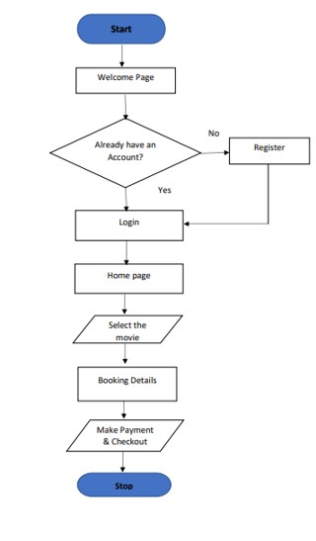
Flow Chart:

Slide 9
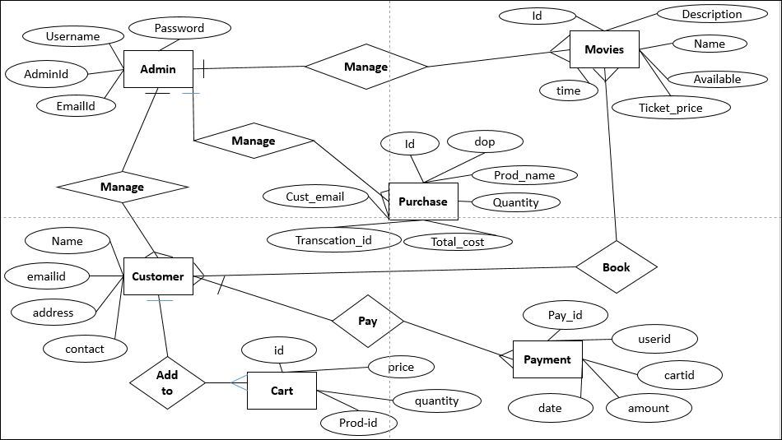
ER-Diagram

Slide 10
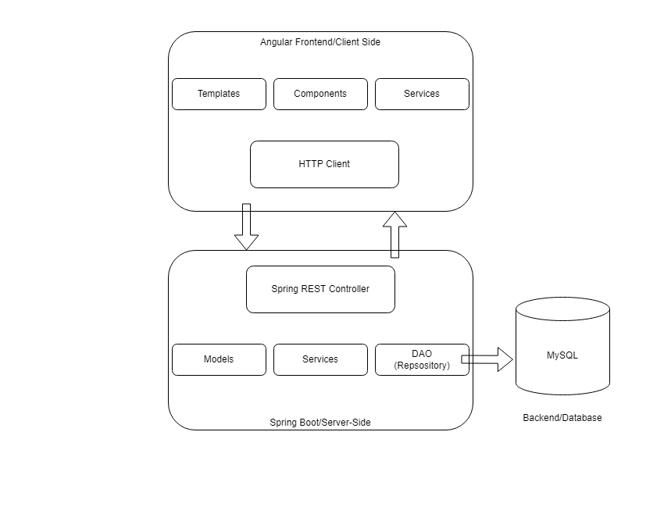
Model Used:

Slide 11
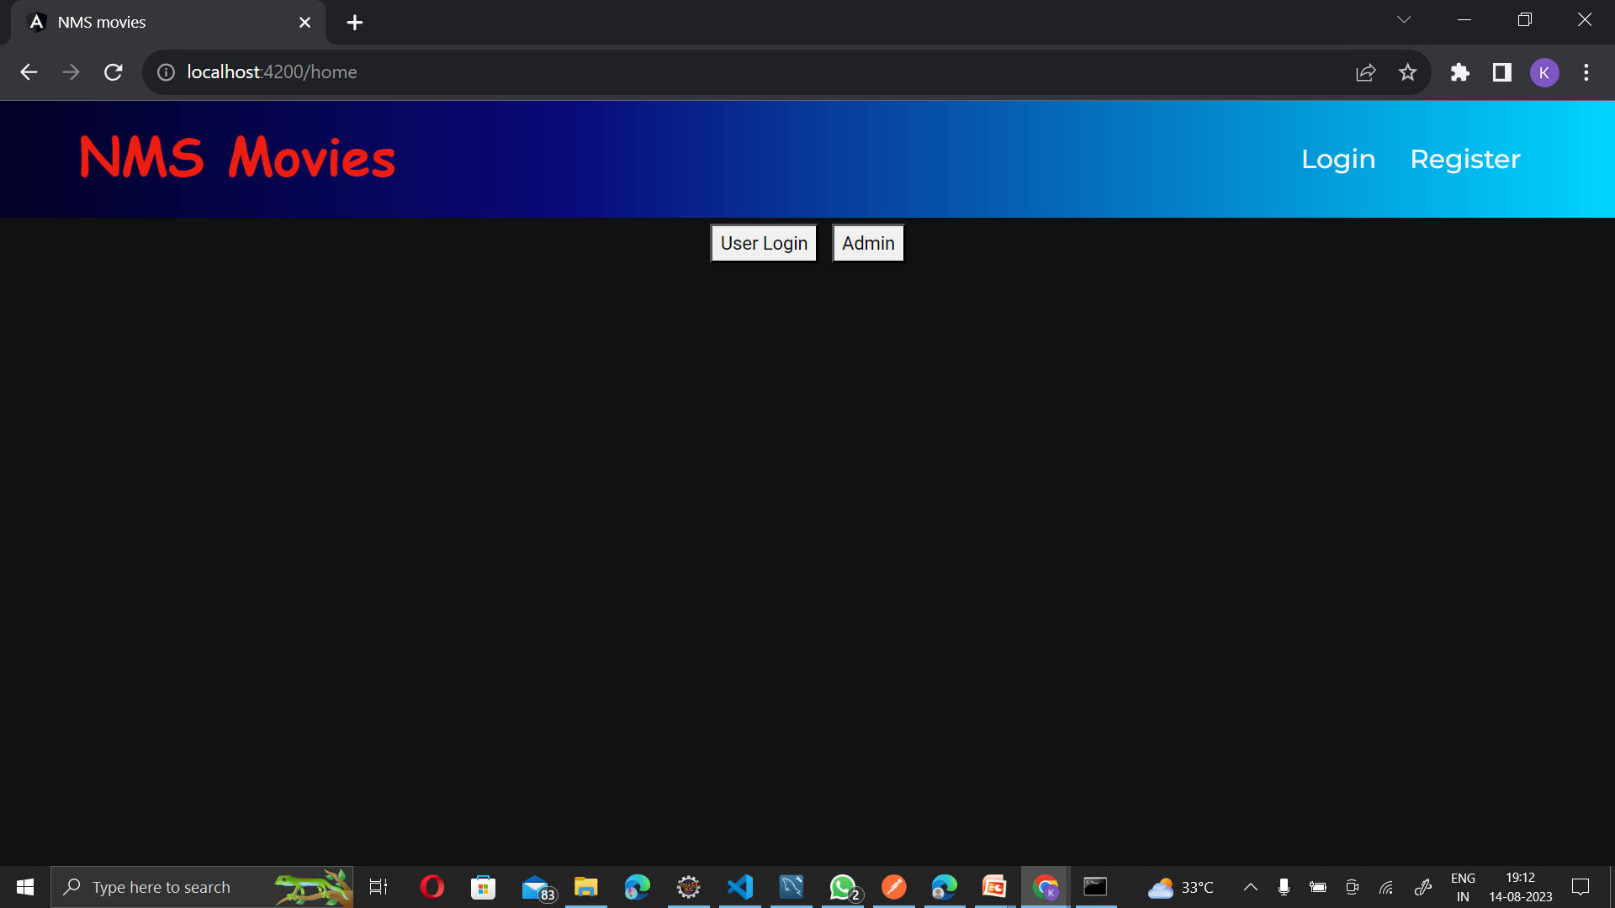
Home Page:

Slide 12
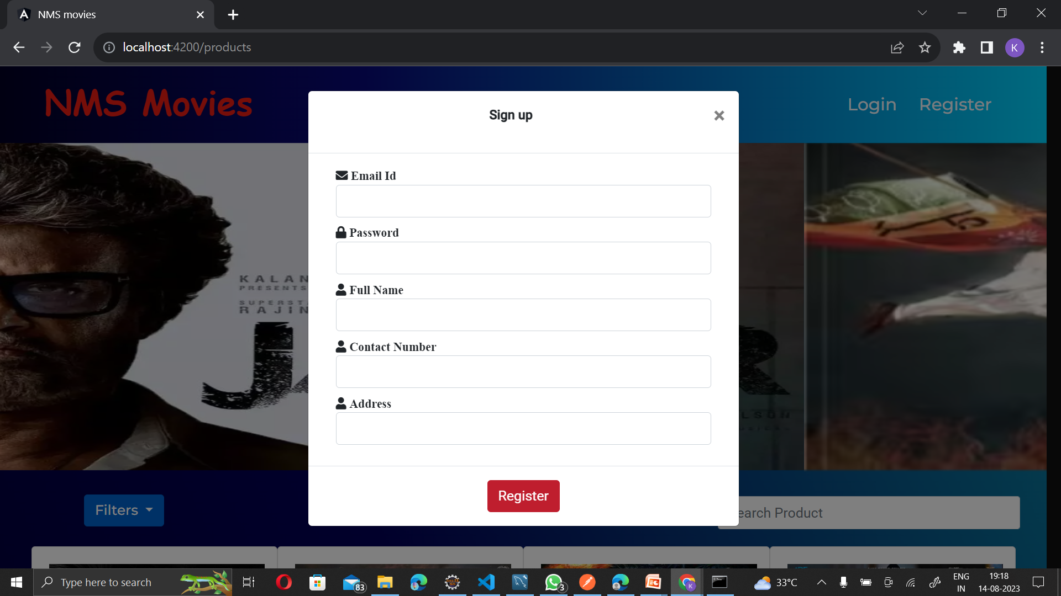
Registration Page:

Slide 13
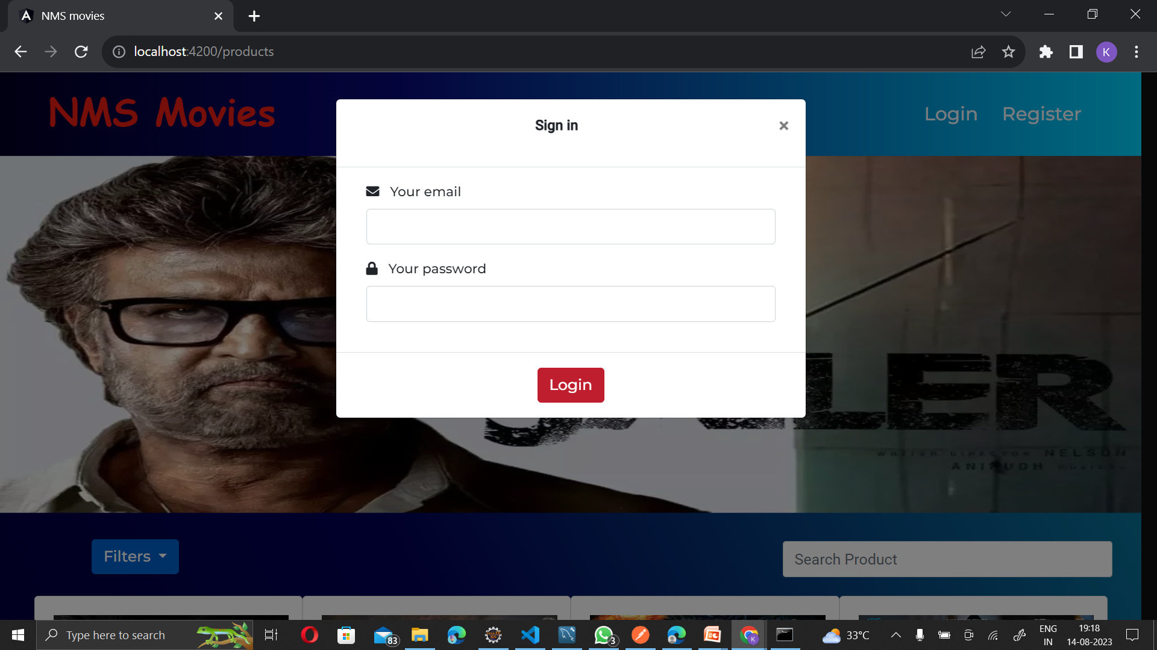
Login Page:

Slide 14
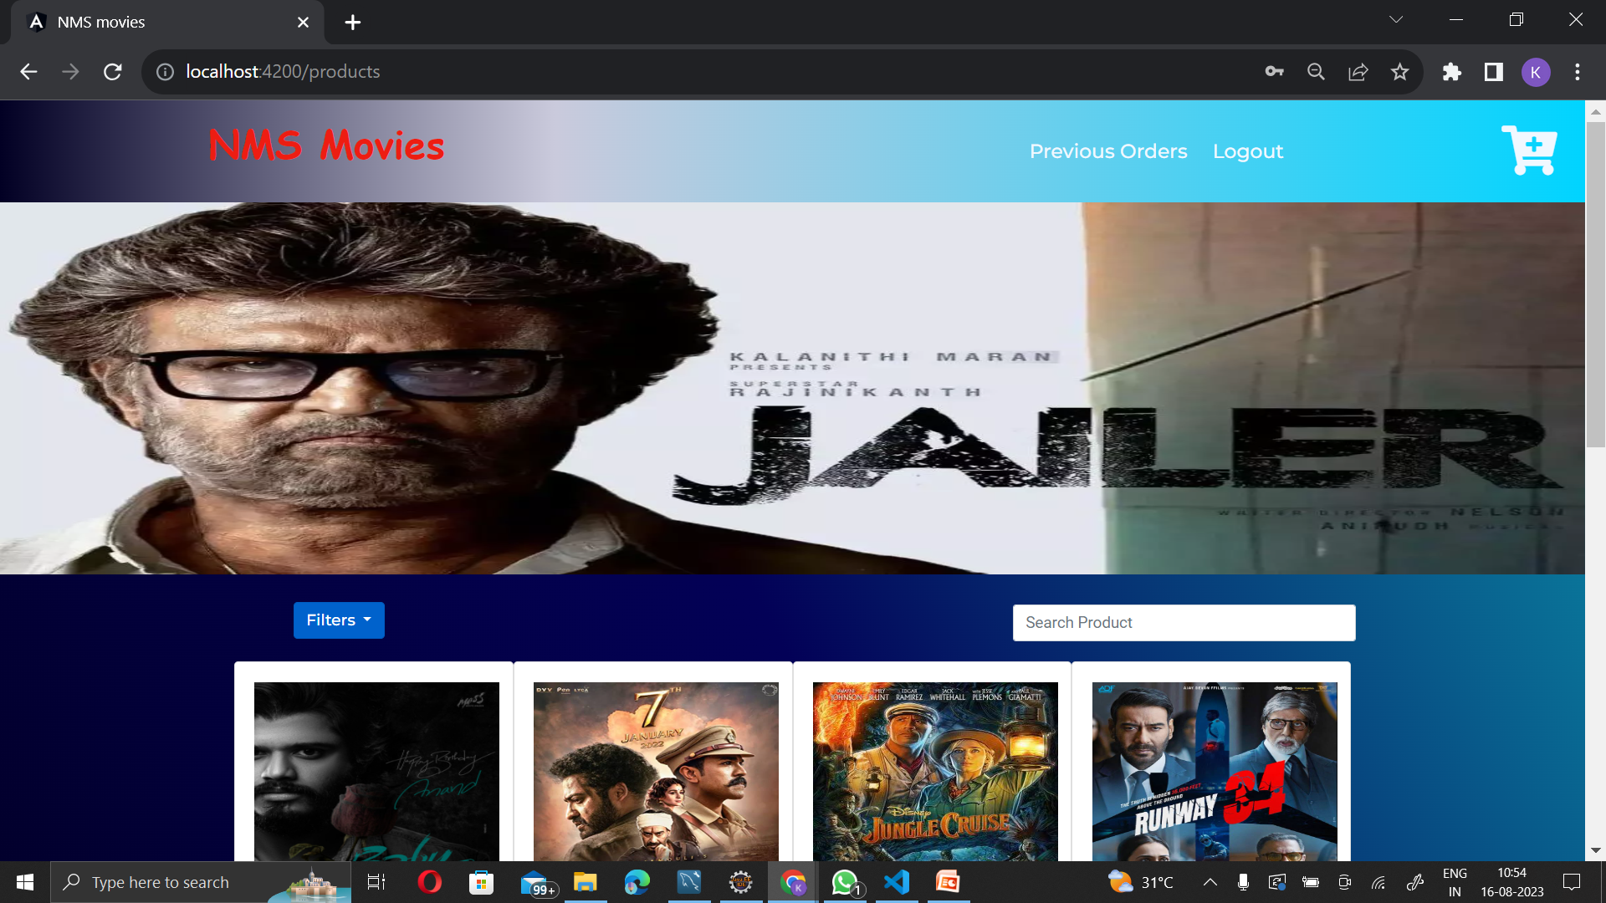
User Dashboard:

Slide 15
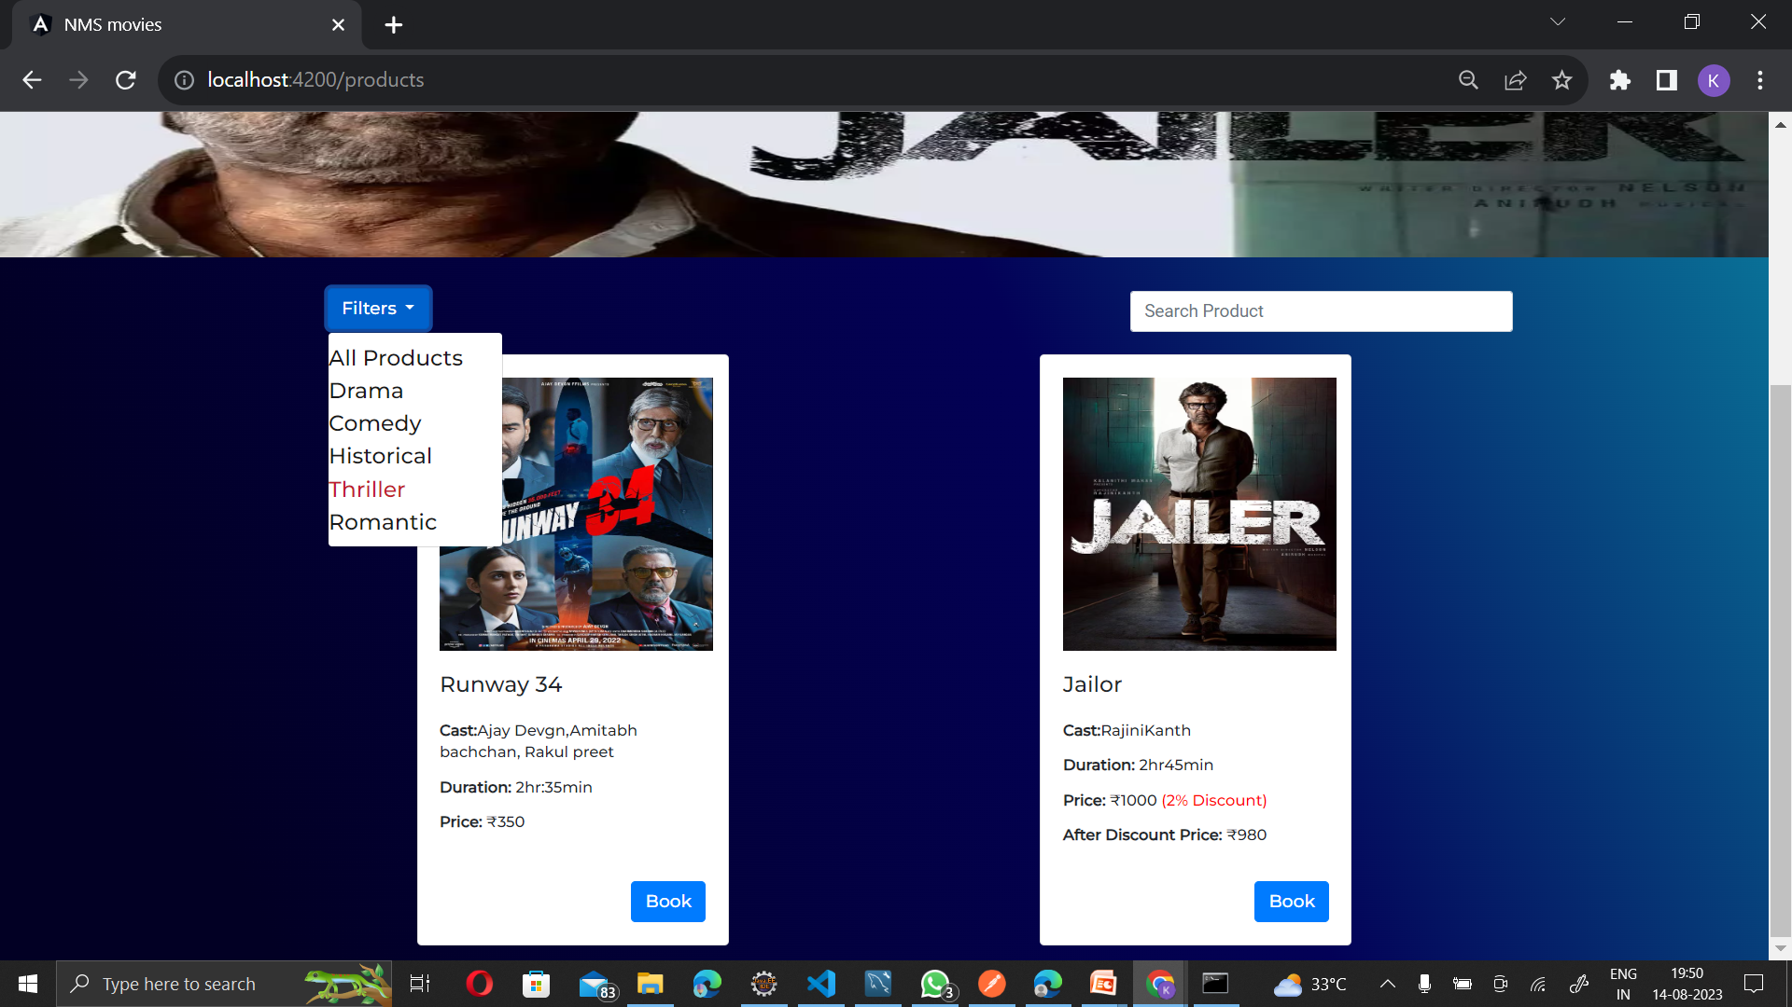
Filter Genres And Search Product:

Slide 16
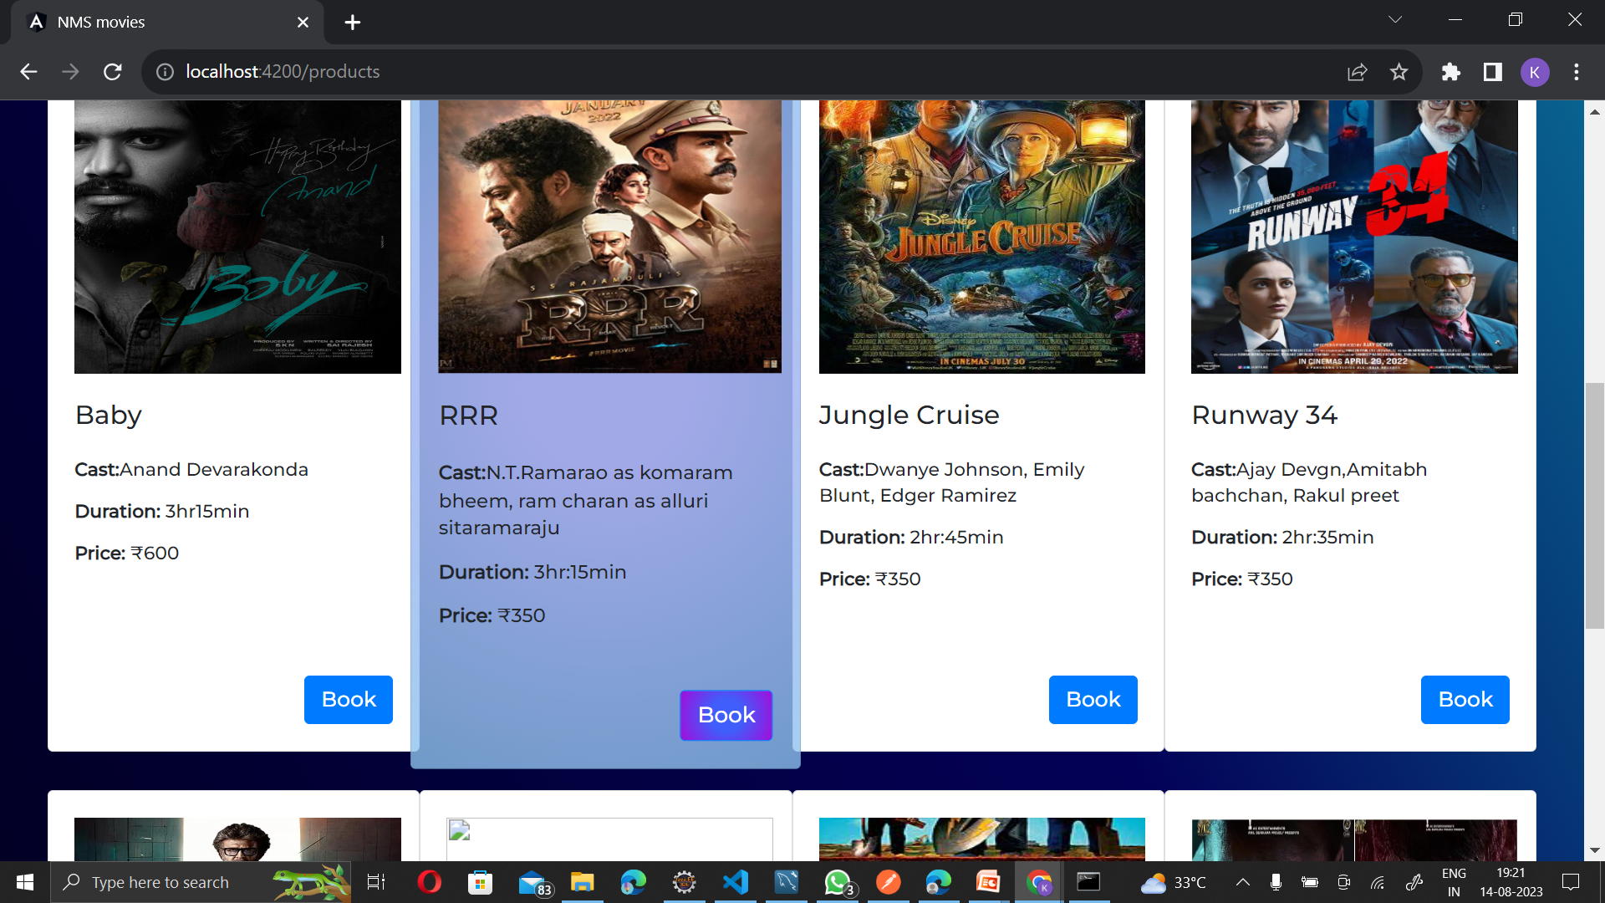
Choose/Book Movie:

Slide 17
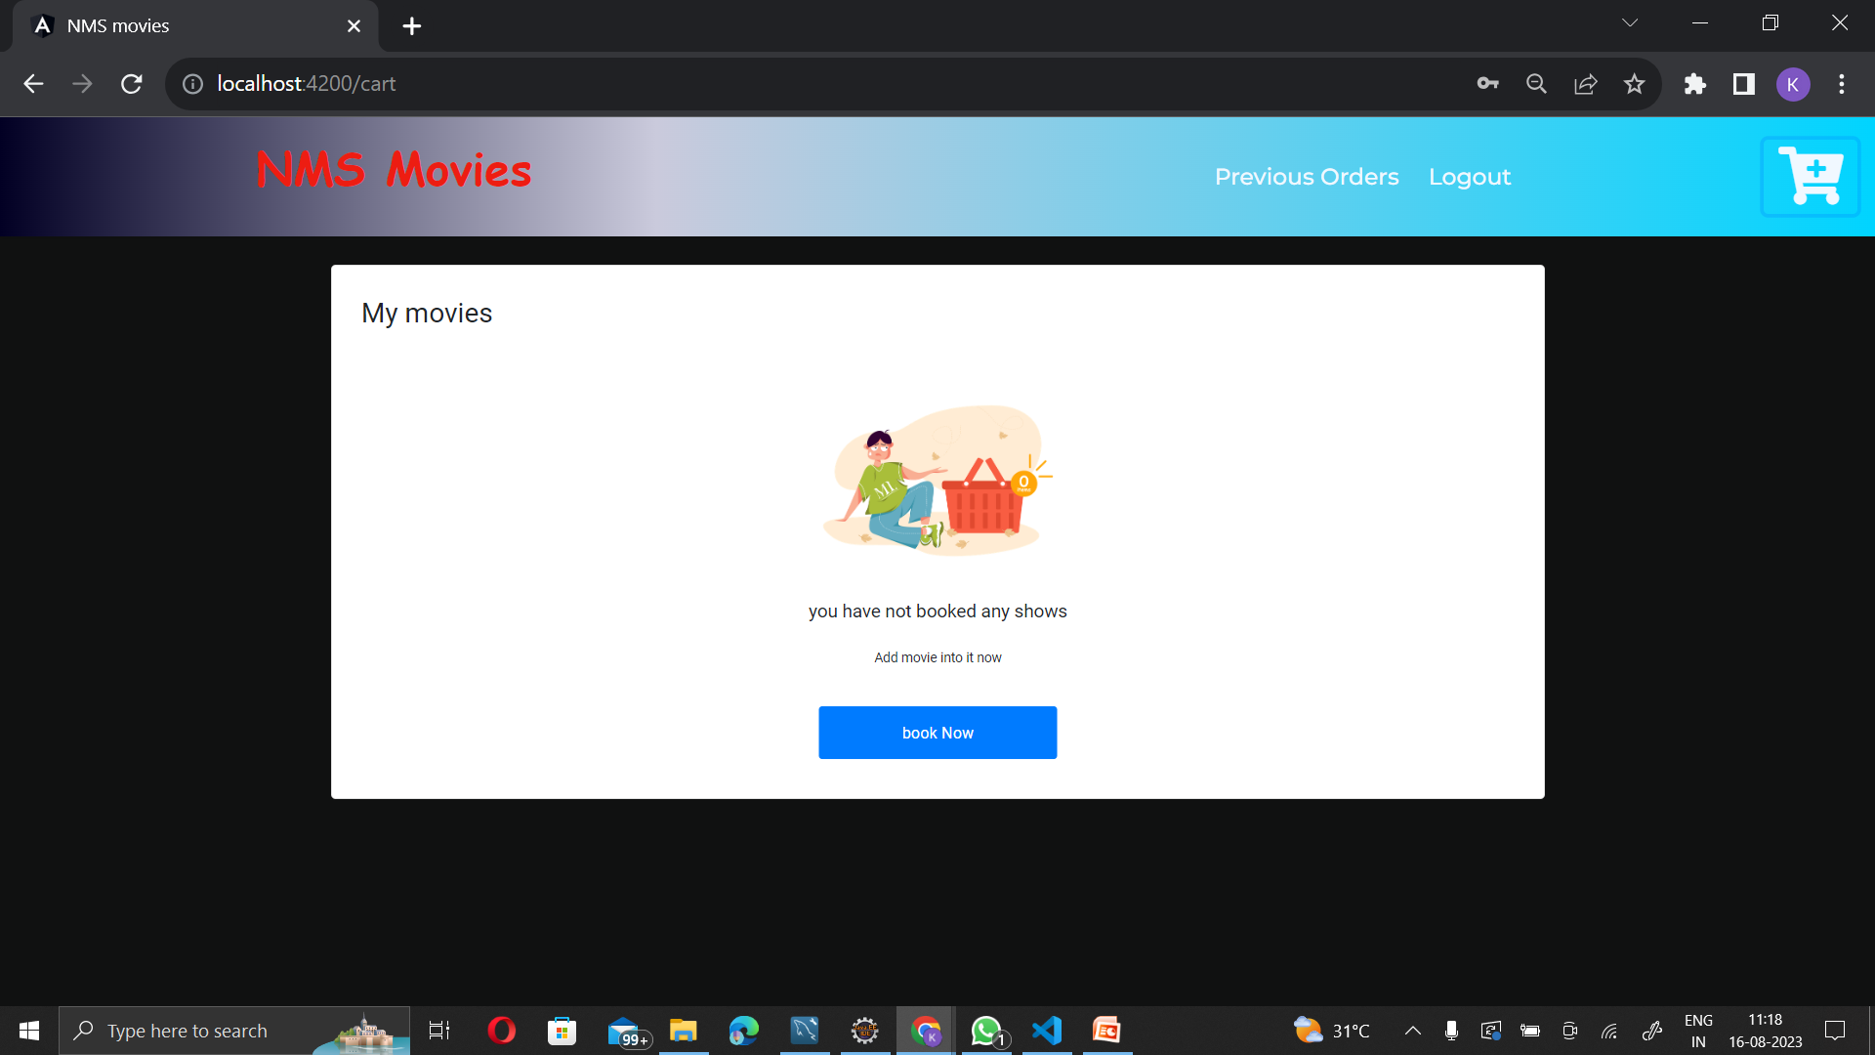
Adding to Cart

Slide 18
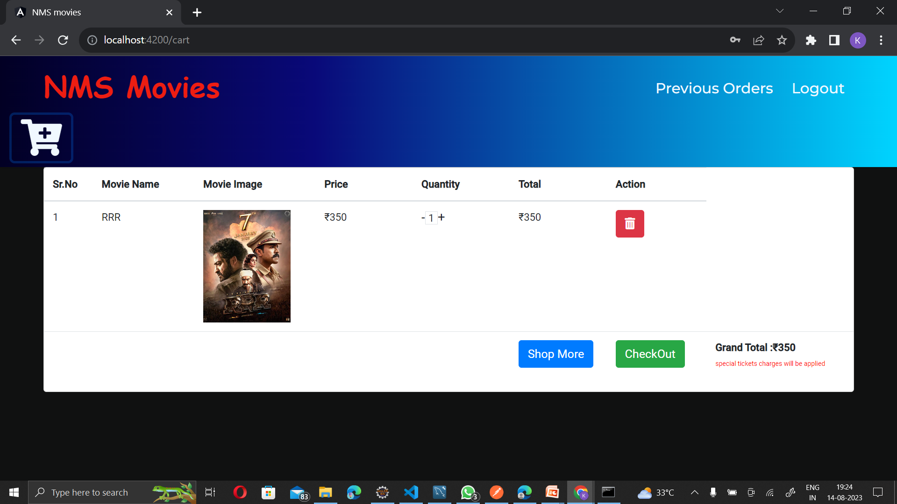
Adding to Cart

Slide 19
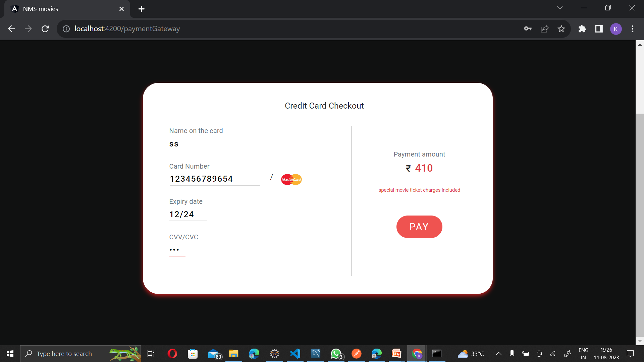
Payment Page:

Slide 20
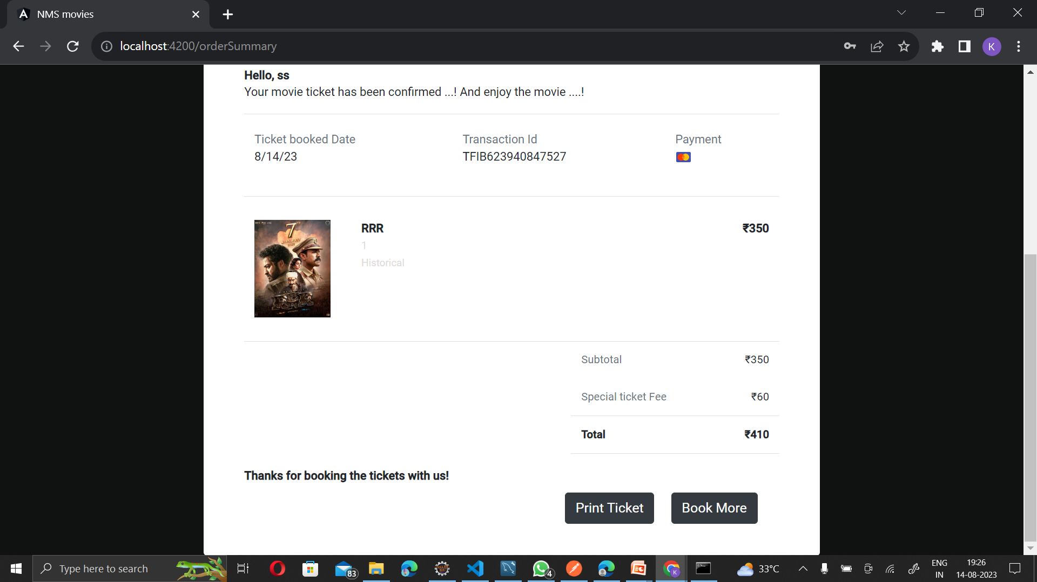
Order Summary Page:

Slide 21
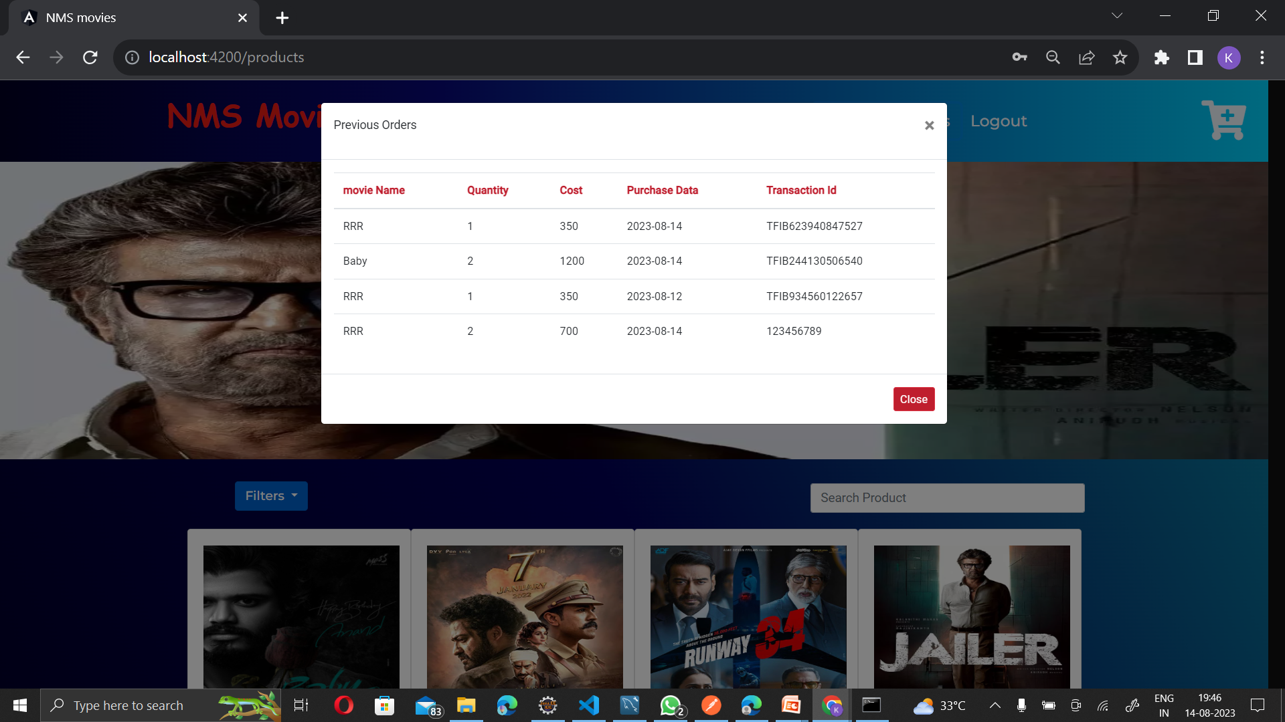
Previous Order:

Slide 22
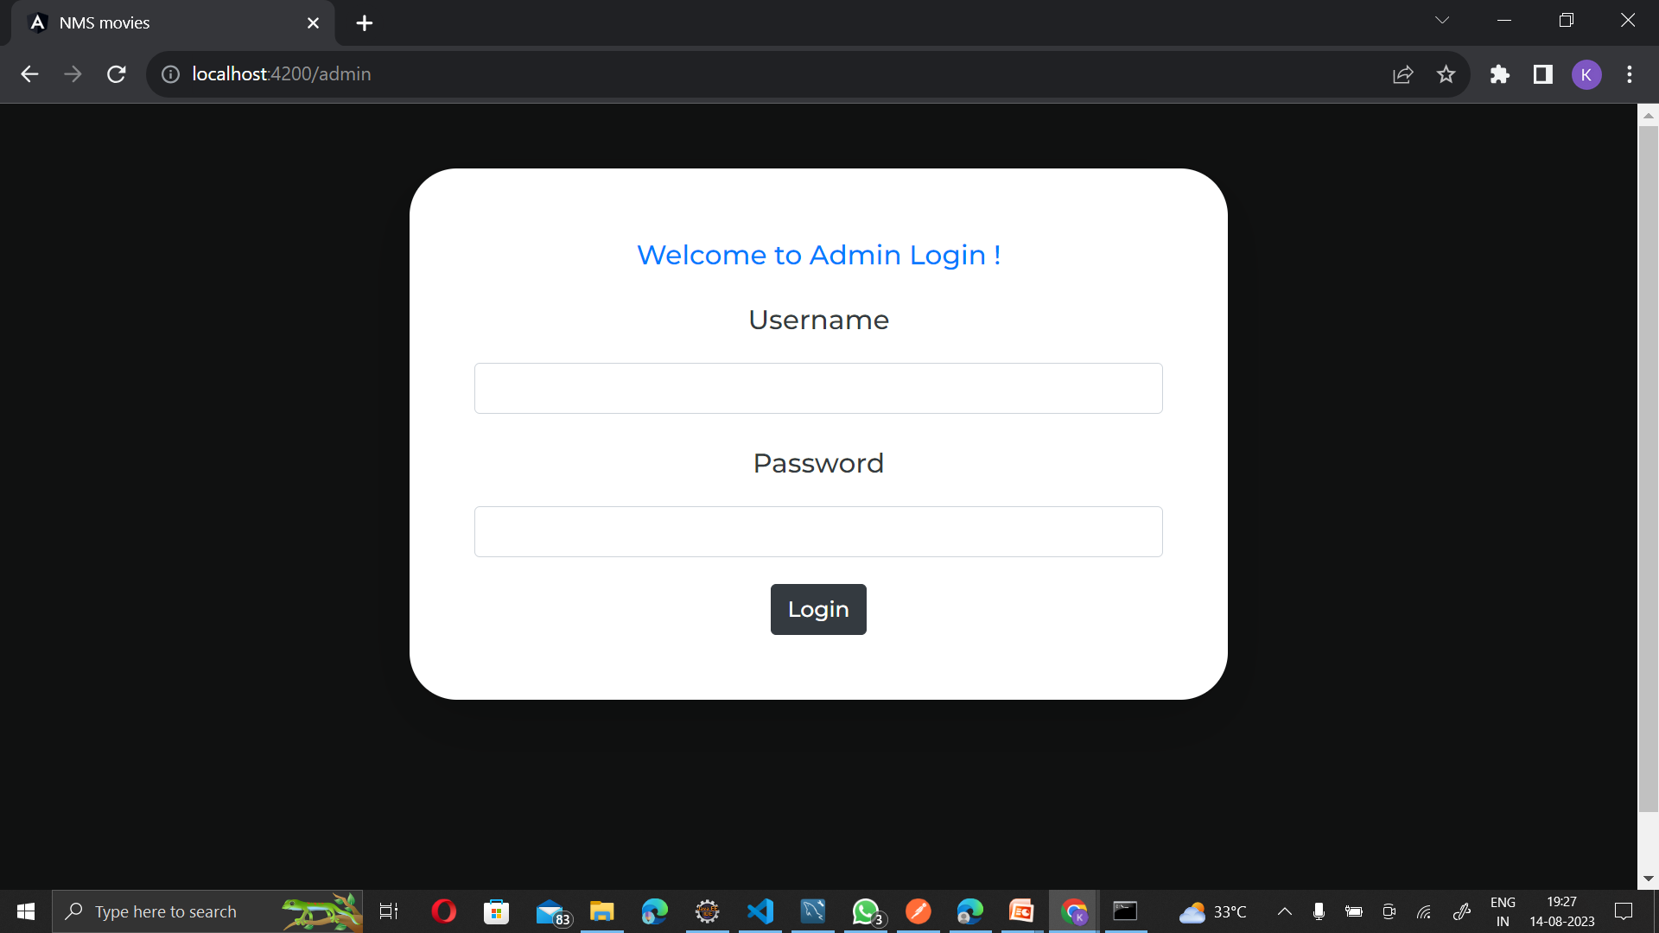
Admin Login:

Slide 23
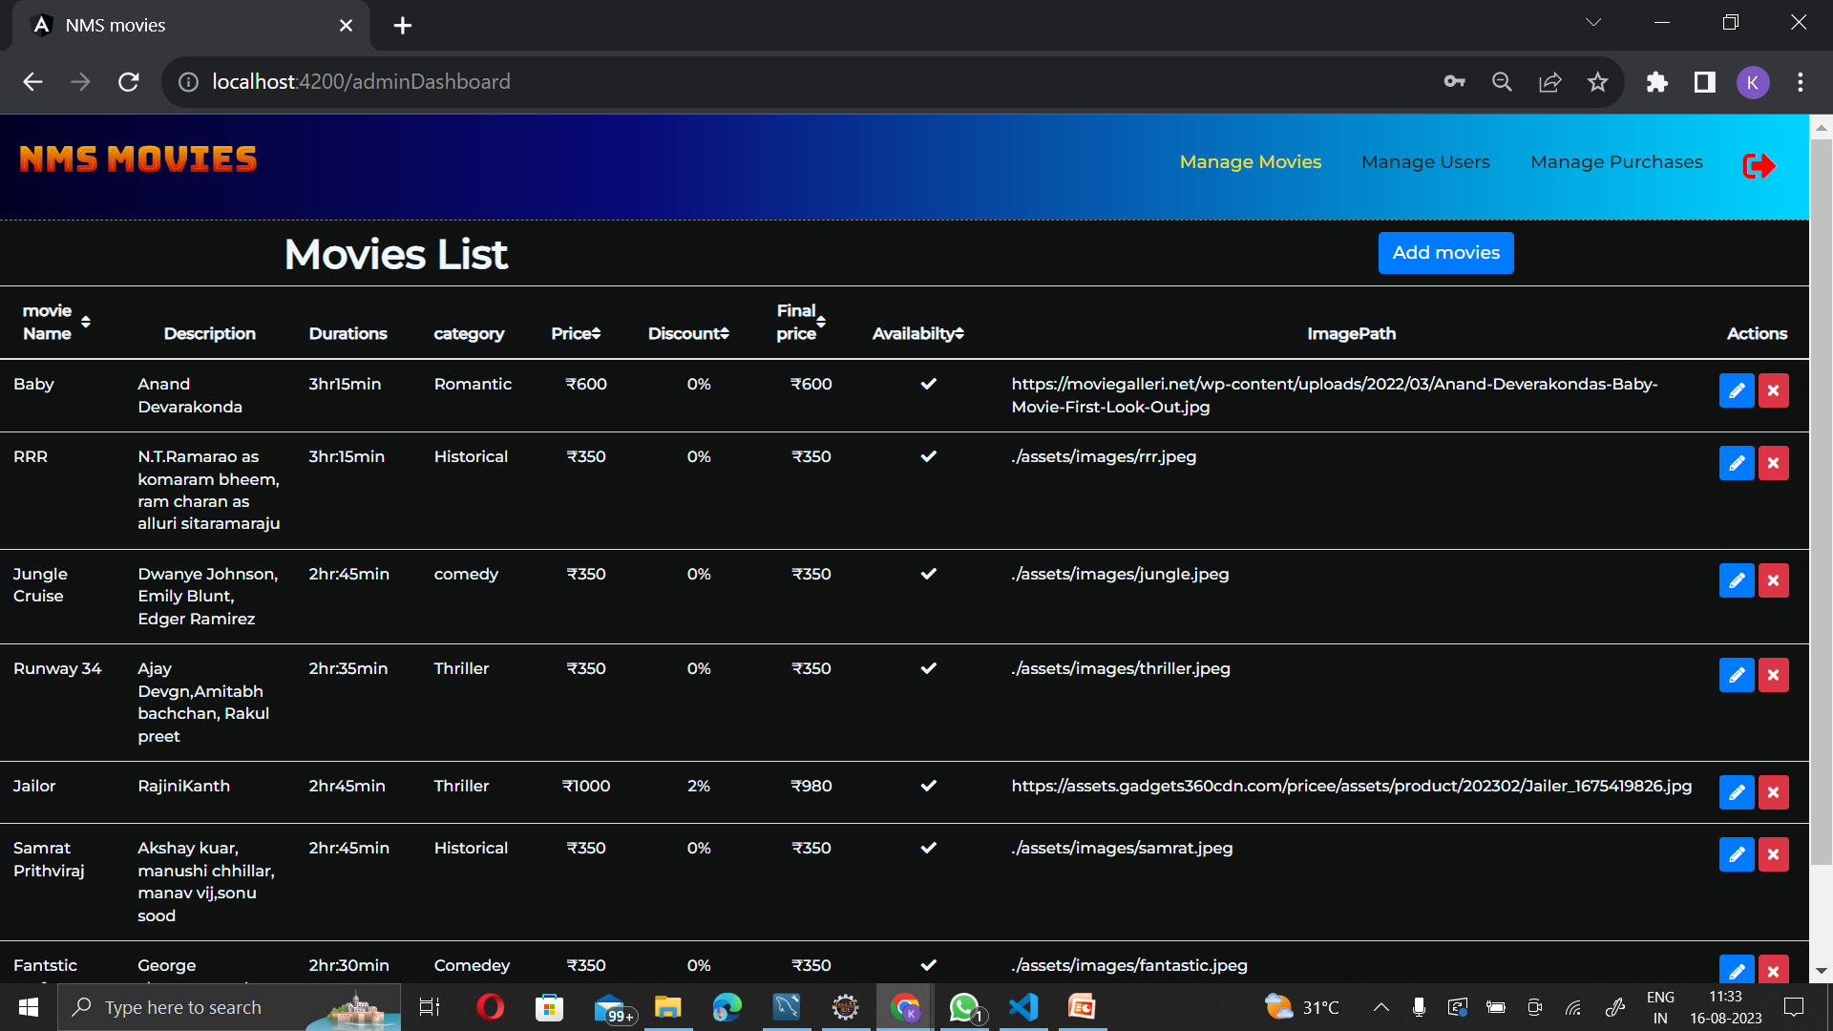
Admin page:

Slide 24
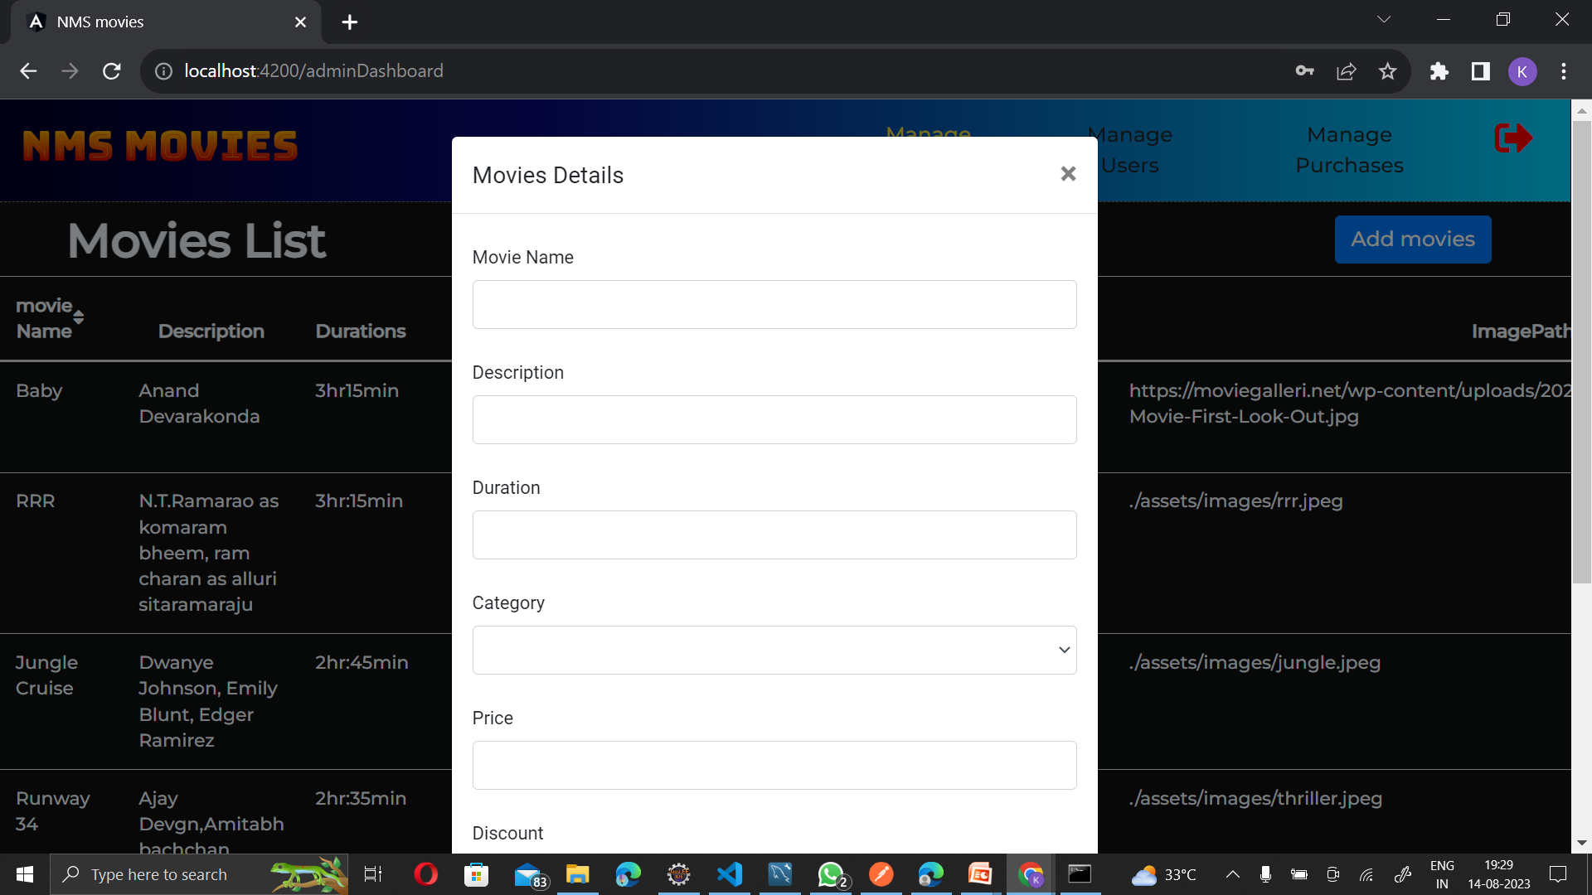
Add Movie:

Slide 25
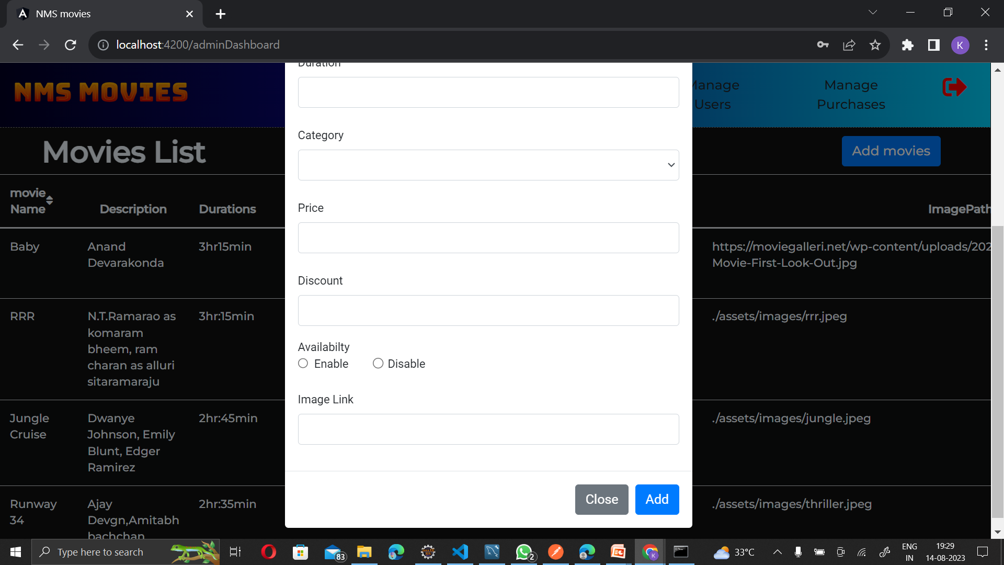
Add Movie

Slide 26
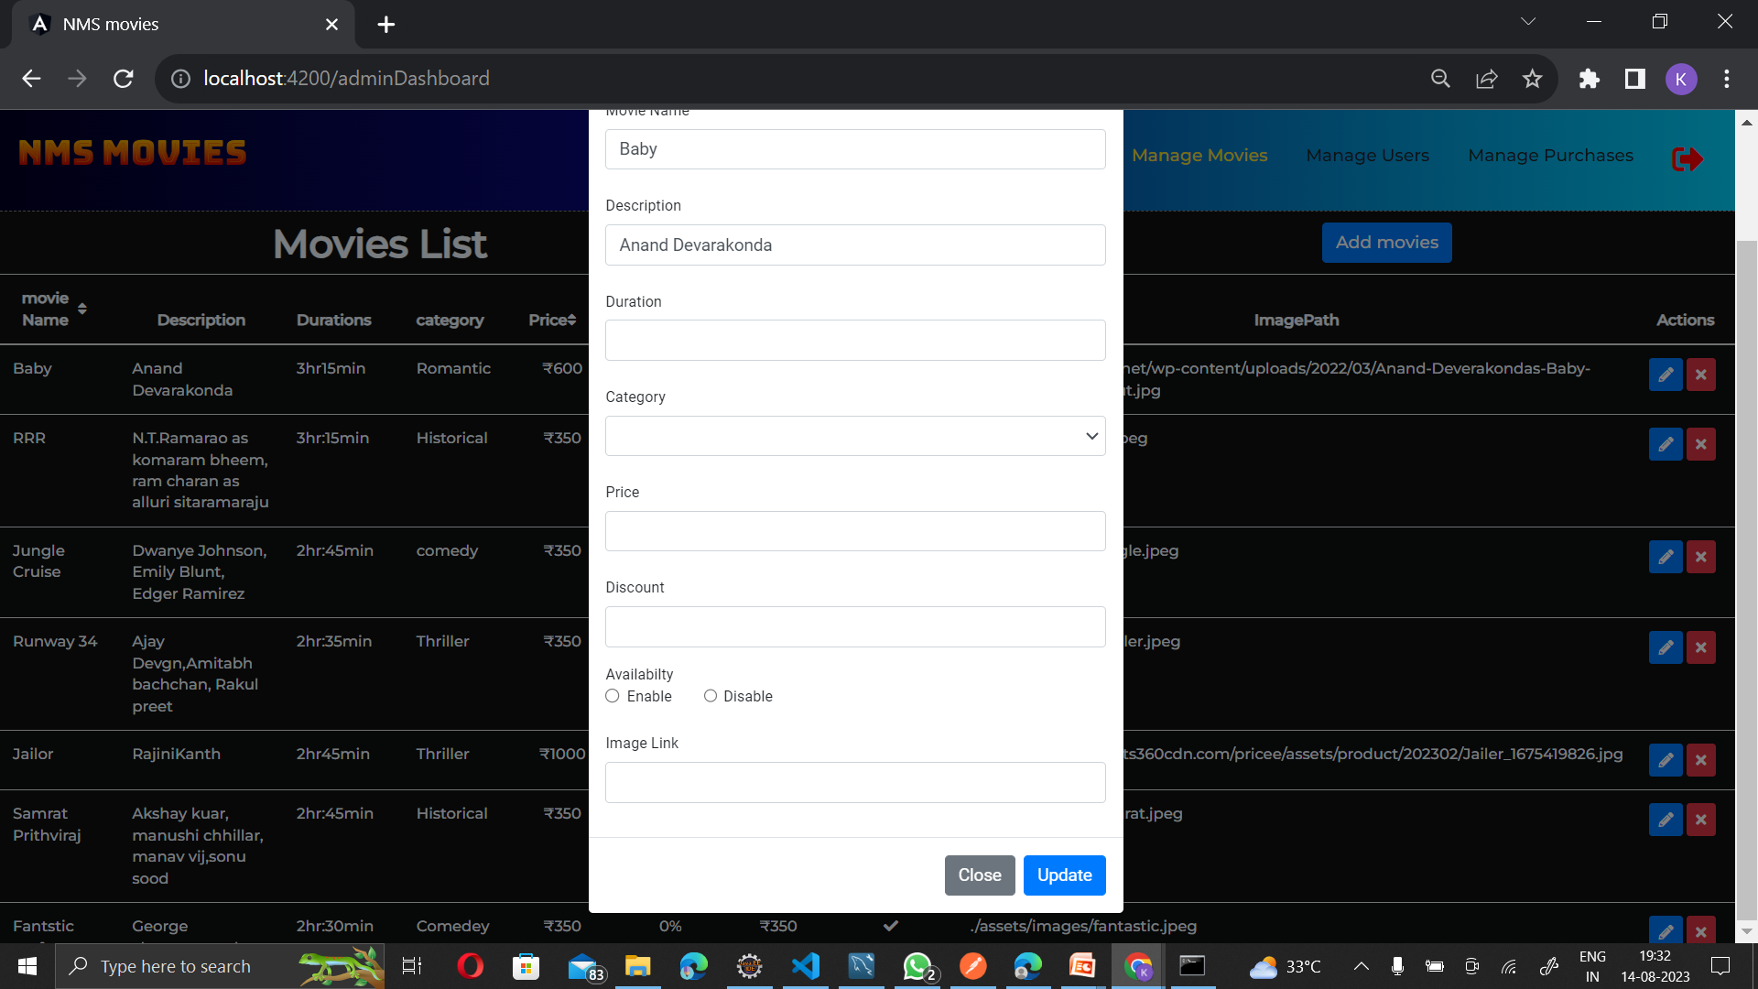
Edit Movie:

Slide 27
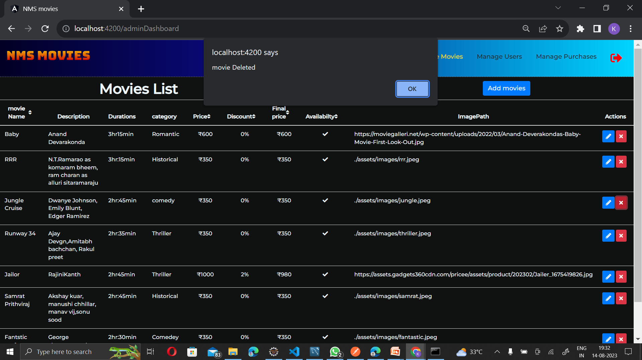
Delete Movie

Slide 28
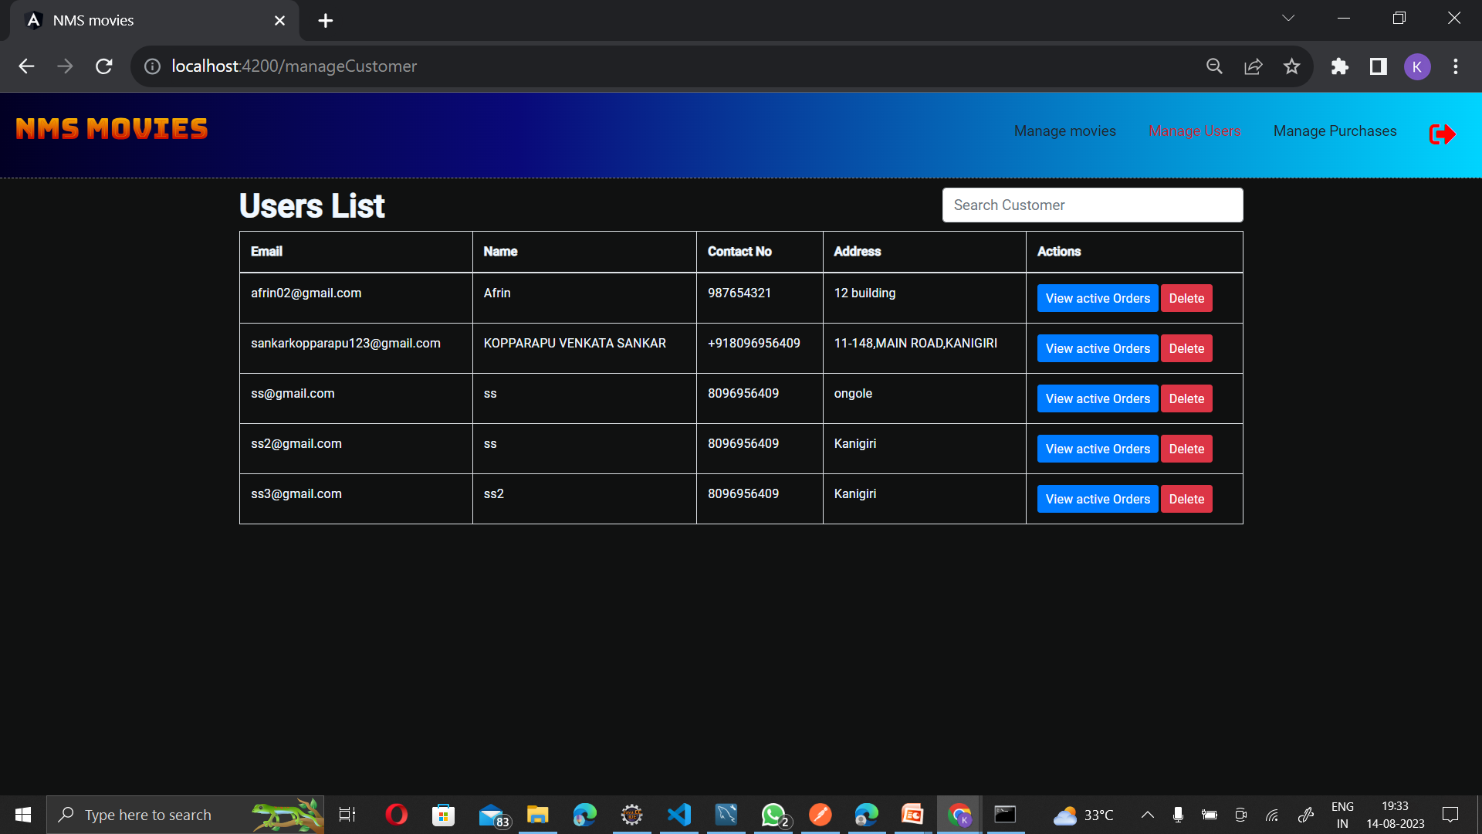
Users List:

Slide 29
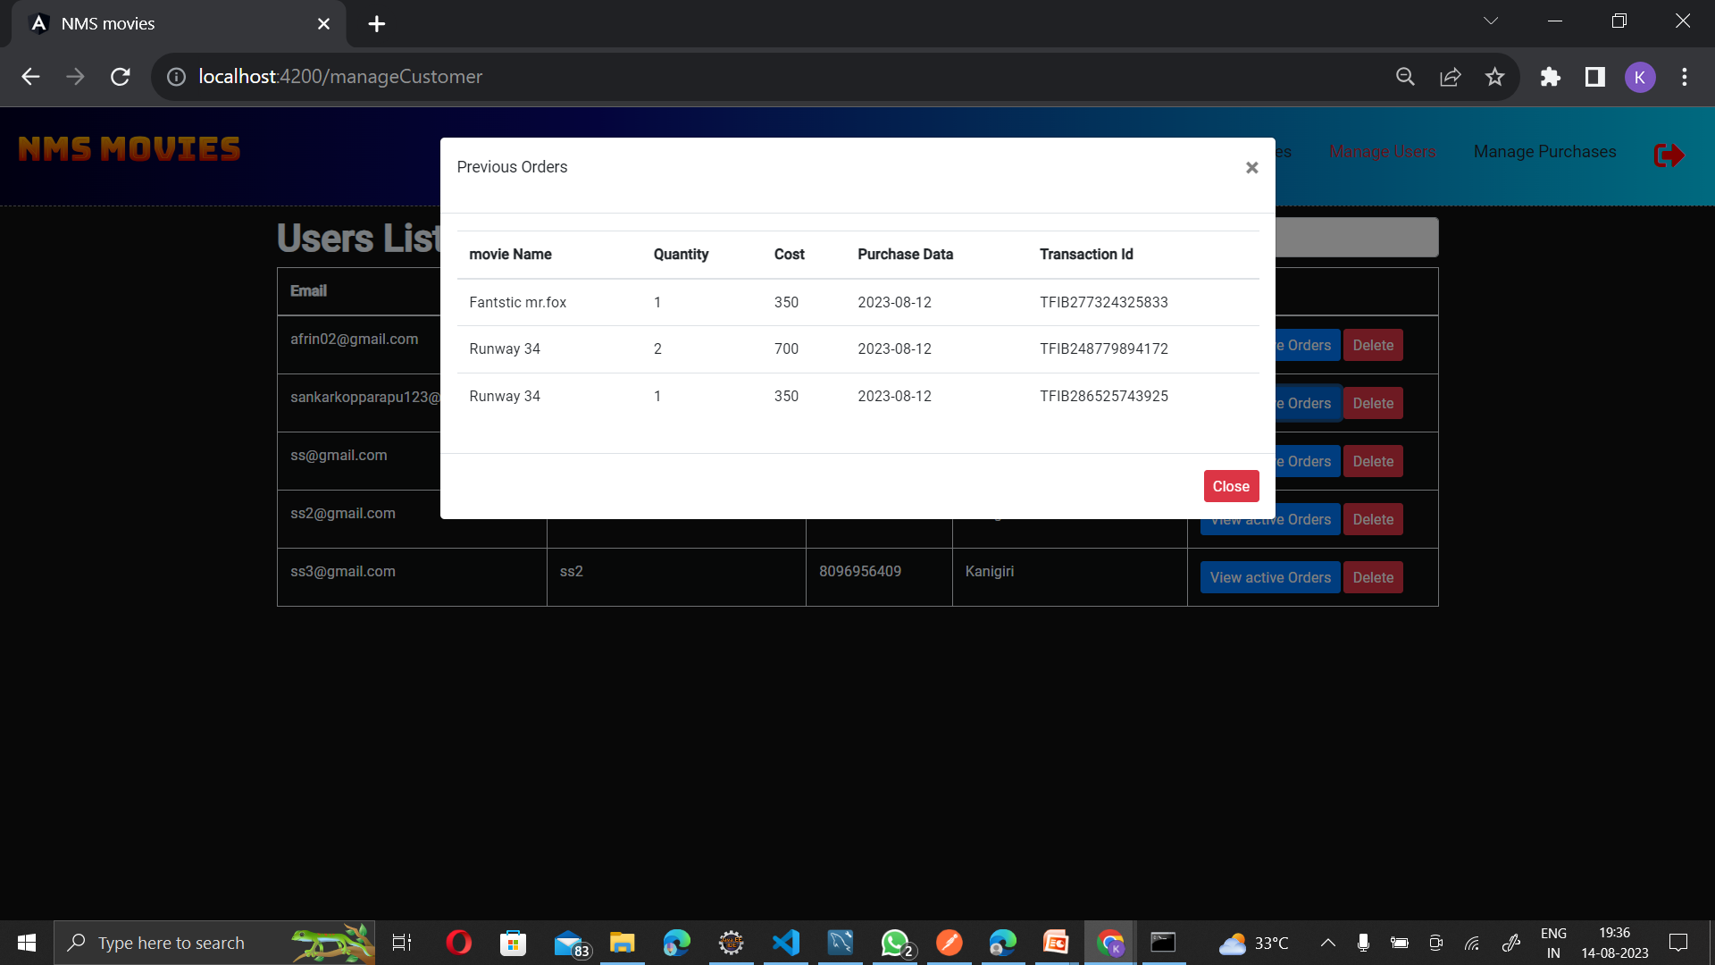
Active Orders of a User:

Slide 30
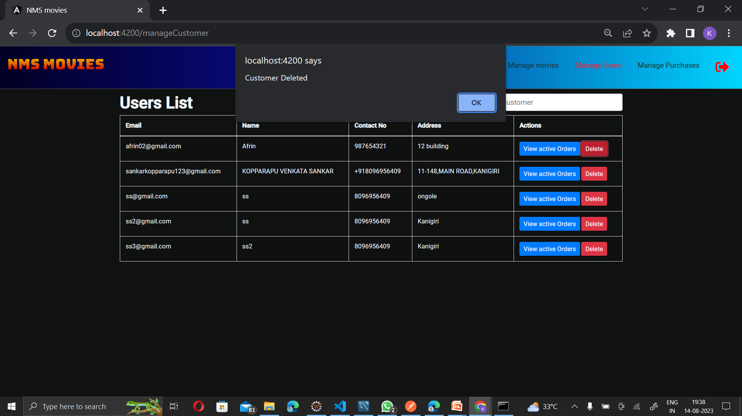
Delete an User:

Slide 31
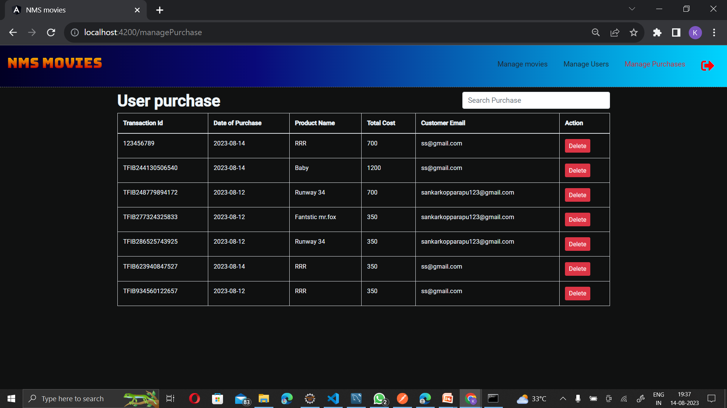
Manage Purchase:

Slide 32
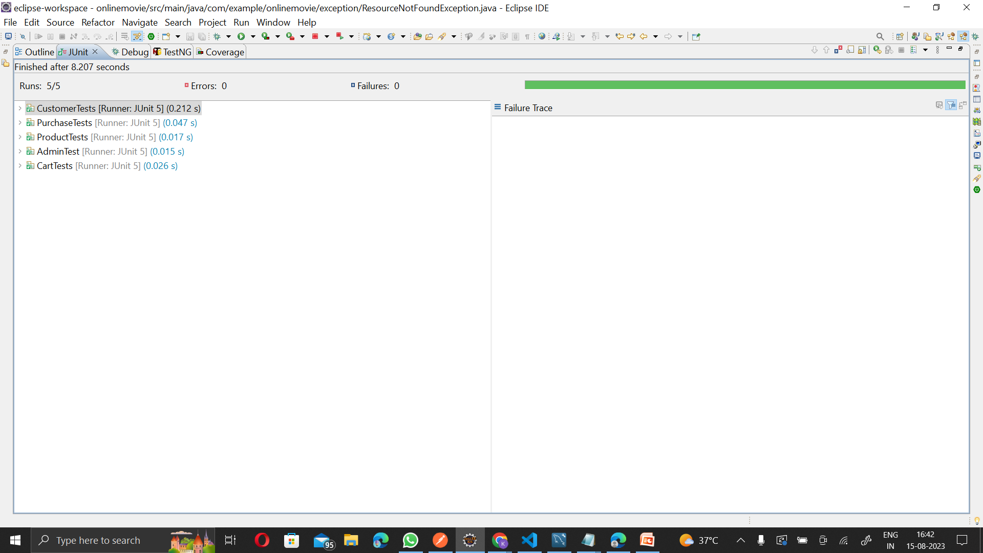
Testing:

Slide 33
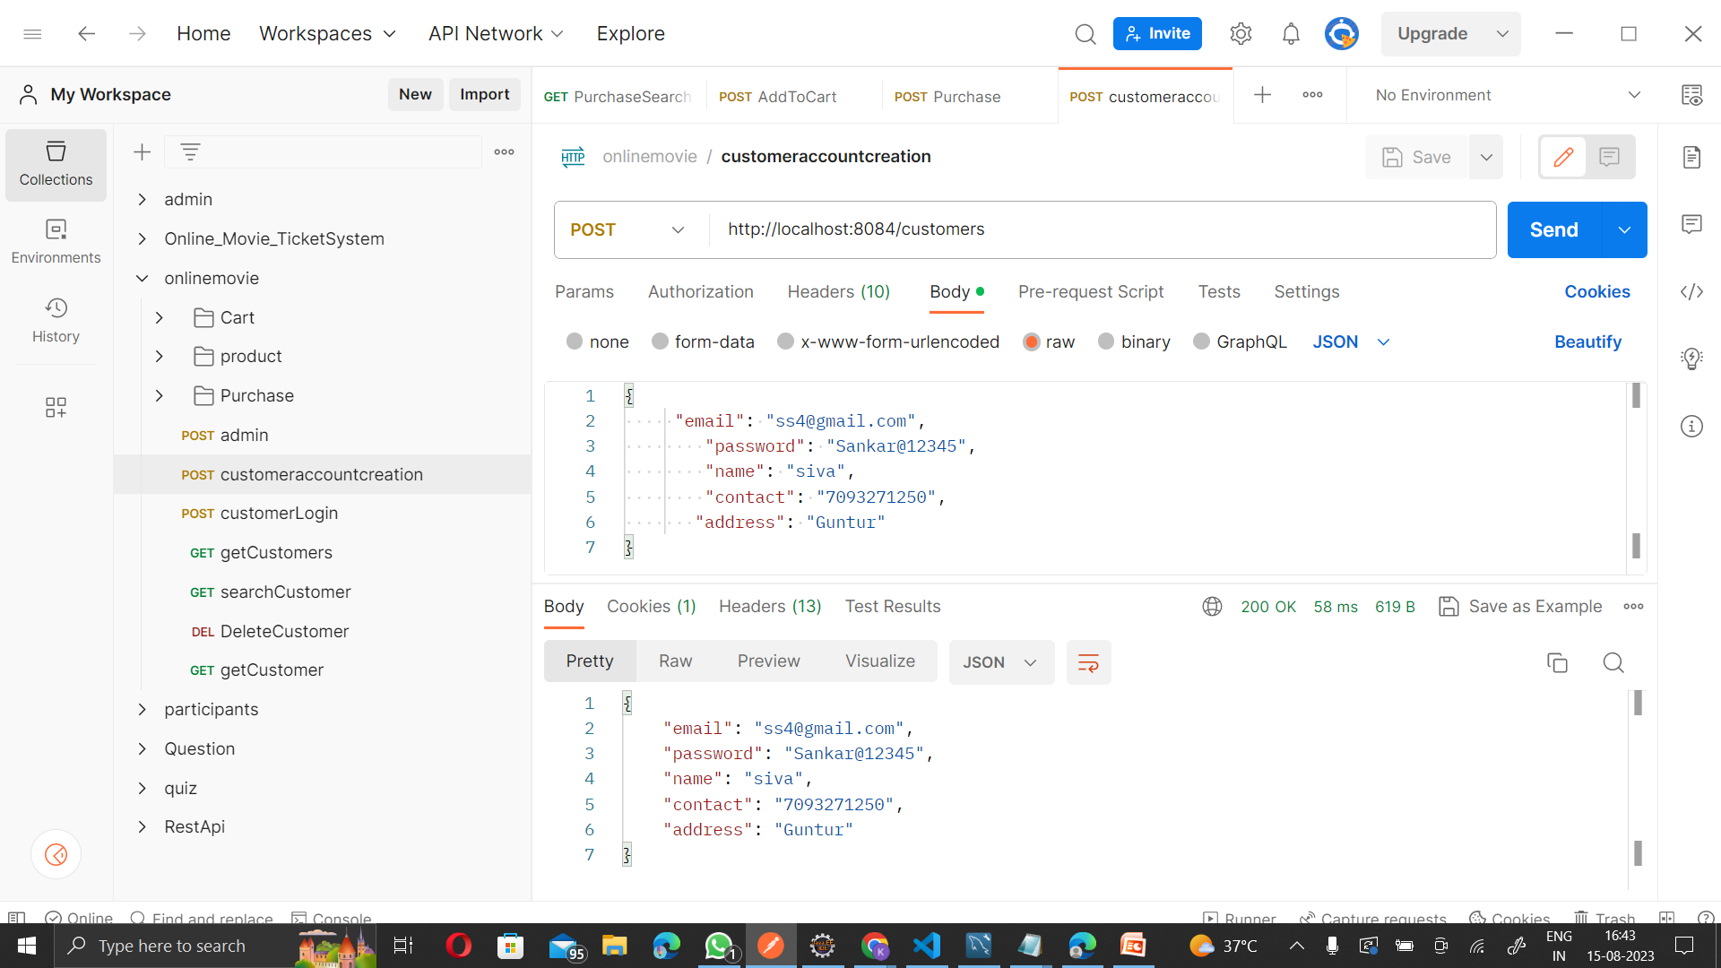
Postman:

Slide 34

Conclusion:
Online Movie Ticket Booking Service.
Benefits of Online Movie Ticket Booking.
How It Works?
Avoiding Queue Hassles.
Overall Impact.

Slide 35

Thank you!

